Slide 1
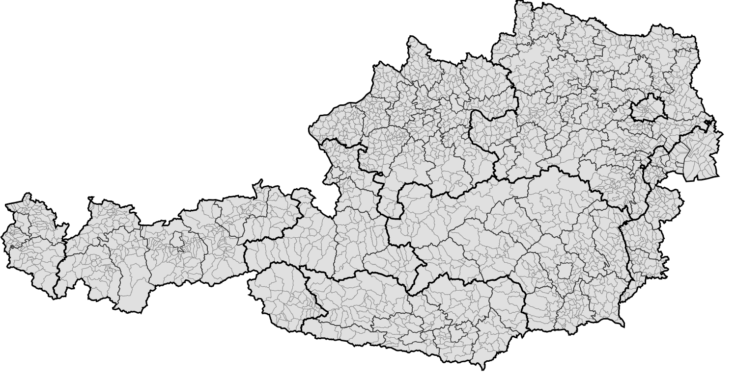
Analysis of Austrian Municipalities (2019)
Nikko Bilitza, January 2023
Xplus1. 2020. "Municipalities of Austria, 2020 dataset, 99.0% simplified, Mercator projection. Grouped by states and districts." Wikimedia Commons, 5 September 2020. https://commons.wikimedia.org/wiki/File:Austrian_Municipalities_2020_template.svg

Slide 2
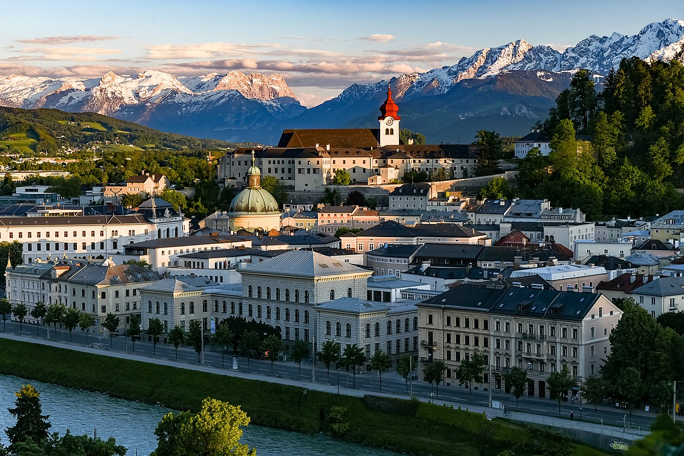
Project Goal
Analyze variations in labor market conditions, education, and demographics across Austrian municipalities, specifically examining differences between villages, towns, cities, and Vienna.
Utilizes data on Austria's 2,207 municipalities collected by Statistics Austria in 2019.
Franganillo, Jorge. 2019. "Salzburg (Austria)." Wikimedia Commons, 18 May 2019. https://commons.wikimedia.org/wiki/File:Salzburg_(48489551981).jpg

Slide 3
Variables of Interest
Employment and Labor Market
Employment Rate (15 to 64)
Unemployment Rate (15 and Older)
Share of Commuters
Education
Share of People with Secondary Education
Share of People with Tertiary Education
Demographics
Average Household Size
Proportion 65 and Older
Proportion Under 15
Share of Non-Austrian Citizens

Slide 4
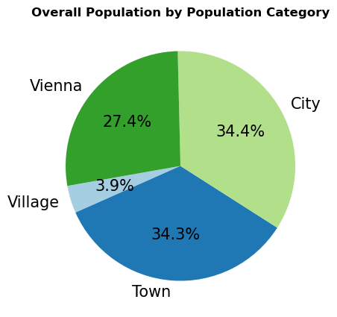
Distribution of Population in Austria
1,048 Villages (0 - 50th percentile) 42 < 1,140 < 1,813 residents
1,027 Towns (50th - 99th percentile) 1,814 < 3,130 < 23,841 residents
20 Cities (99th - 100th excluding Vienna) 24,473 < 41,932 < 290,540 residents
Vienna 1,908,104 residents

Slide 5
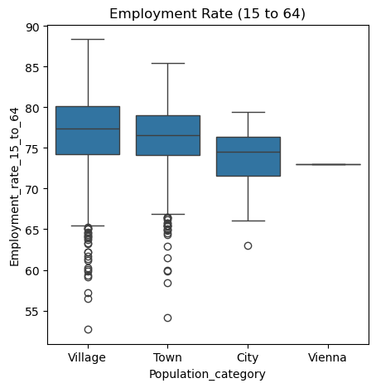
Employment and Labor Market
Employment Rate (15 to 64) ANOVA:
F-statistic: 13.28
p-value: 1.36e-08
Highly statistically significant.

Slide 6
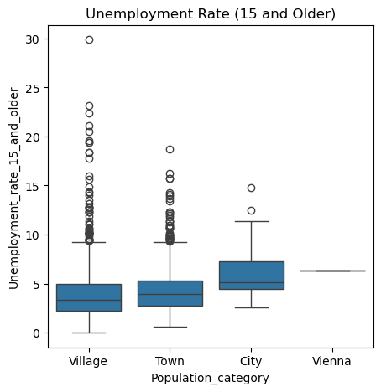
Employment and Labor Market
Unemployment Rate (15 and Older) ANOVA:
F-statistic: 10.75
p-value: 5.17e-07
Highly statistically significant.

Slide 7
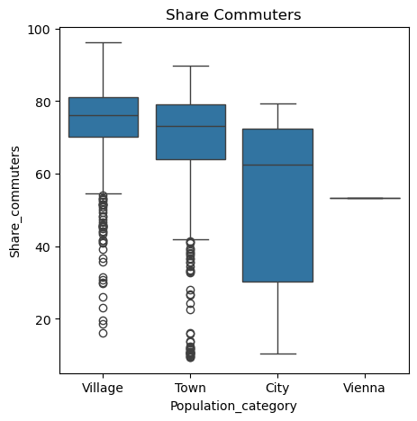
Employment and Labor Market
Share of Commuters ANOVA:
F-statistic: 61.88
p-value: 2.48e-38
Highly statistically significant.

Slide 8
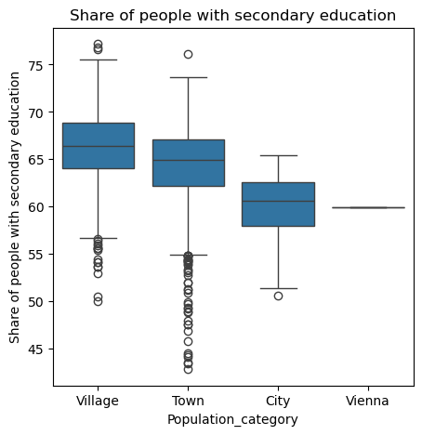
Education
Share of People with Secondary Education ANOVA:
F-statistic: 68.26
p-value: 4.12e-42
Highly statistically significant.

Slide 9
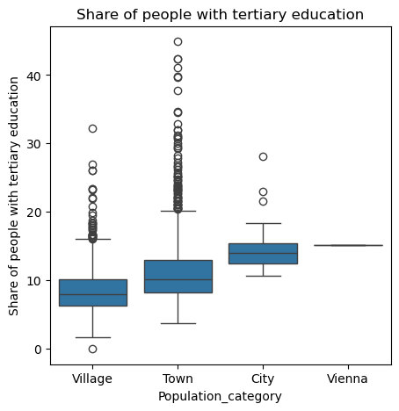
Education
Share of People with Tertiary Education ANOVA:
F-statistic: 89.15
p-value: 2.74e-54
Highly statistically significant.

Slide 10
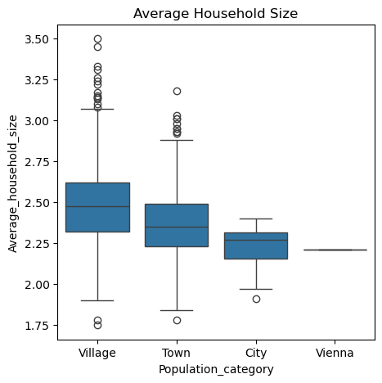
Demographics
Average Household Size ANOVA:
F-statistic: 58.48
p-value: 2.64e-36
Highly statistically significant.

Slide 11
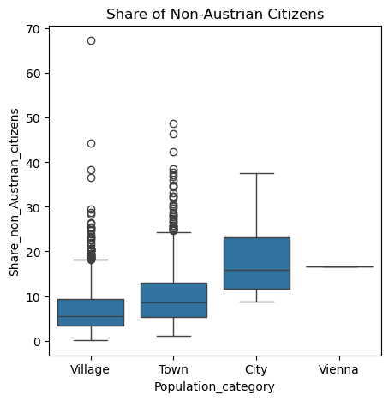
Demographics
Share of Non-Austrian Citizens ANOVA:
F-statistic: 67.87
p-value: 6.97e-42
Highly statistically significant

Slide 12
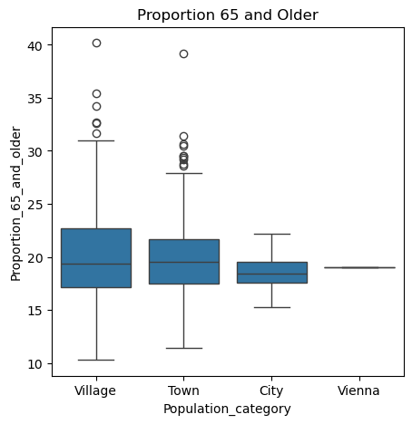
Demographics
Proportion 65 and Older ANOVA:
F-statistic: 0.34
p-value: 0.78
Not statistically significant (p > 0.05).

Slide 13
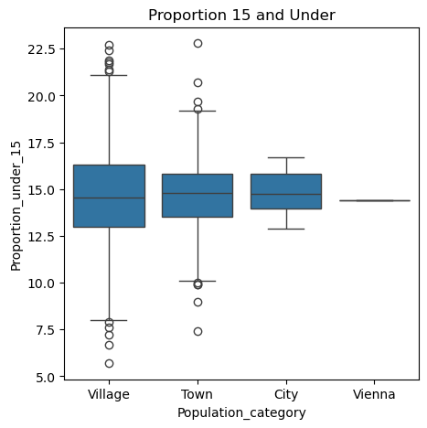
Demographics
Proportion 15 and Under ANOVA:
F-statistic: 1.82
p-value: 0.14
Not statistically significant (p > 0.05).

Slide 14
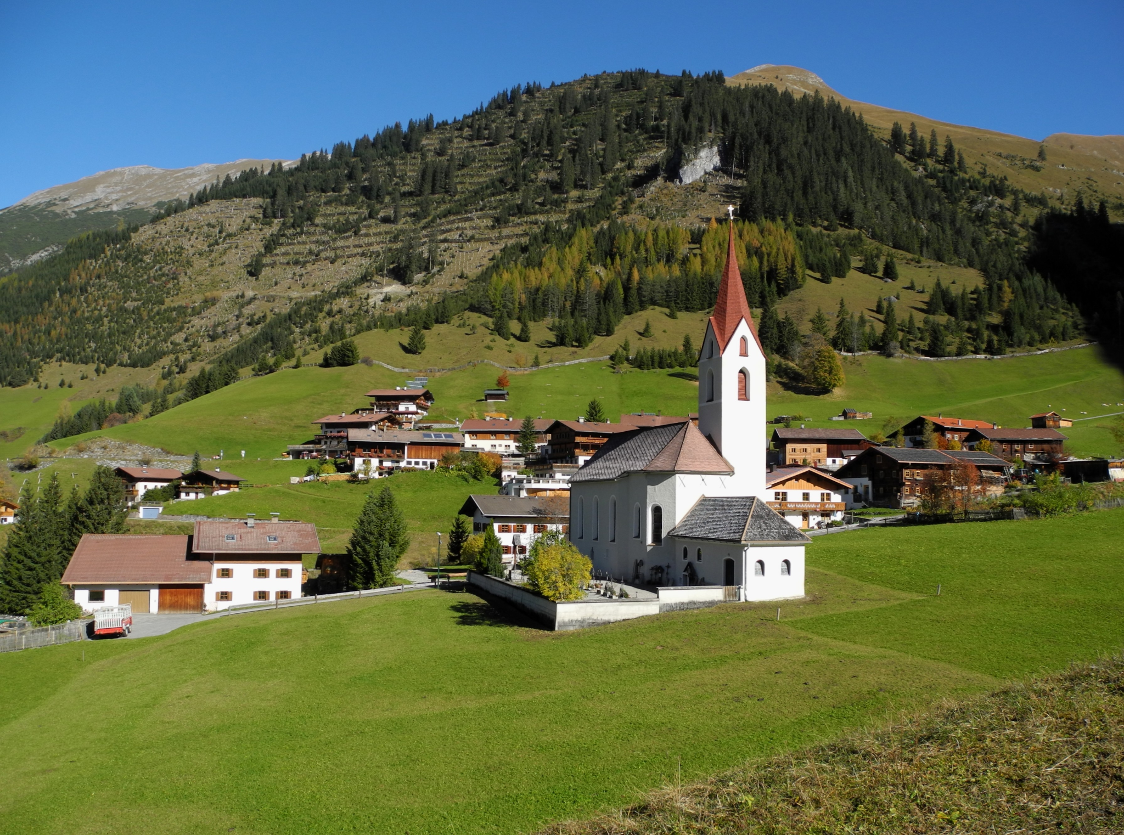
Outlier Analysis: Gramais, Tyrol
Gramais stands out as the smallest municipality with a population of merely 42 residents.
Franzfoto. 2012. "Gramais - Ort mit Seitekopf." Wikimedia Commons, October 2012. https://commons.wikimedia.org/wiki/File:Gramais_-_Ort_mit_Seitekopf.JPG

Slide 15
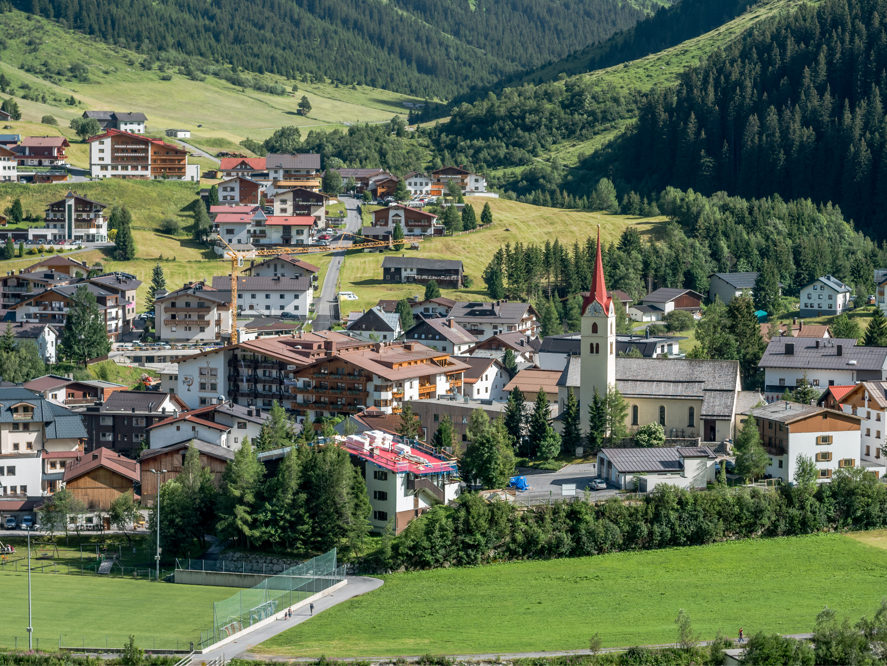
Outlier Analysis: Galtür, Tyrol
Galtür, a small ski resort town with a population of 765, has the highest unemployment rate at 29.9 percent.
Basotxerri. 2017. "View over the centre of Galtür. Paznaun, Tyrol, Austria." Wikimedia Commons, 9 July 2017. https://commons.wikimedia.org/wiki/File:Galt%C3%BCr_-_Ortszentrum_01.jpg

Slide 16
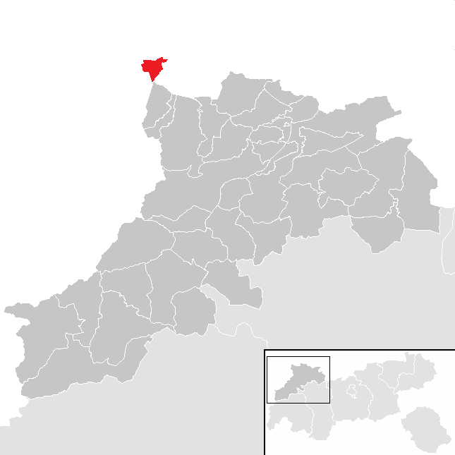
Outlier Analysis: Jungholz, Tyrol
Jungholz holds the record for the highest proportion of non-Austrian citizens (67.3%) among Austrian municipalities, attributed to its unique geographic position as an exclave surrounded by Germany.
Täubler, Joschi. "District Reutte." Wikimedia Commons. https://commons.wikimedia.org/wiki/File:Jungholz_im_Bezirk_RE.png

Slide 17
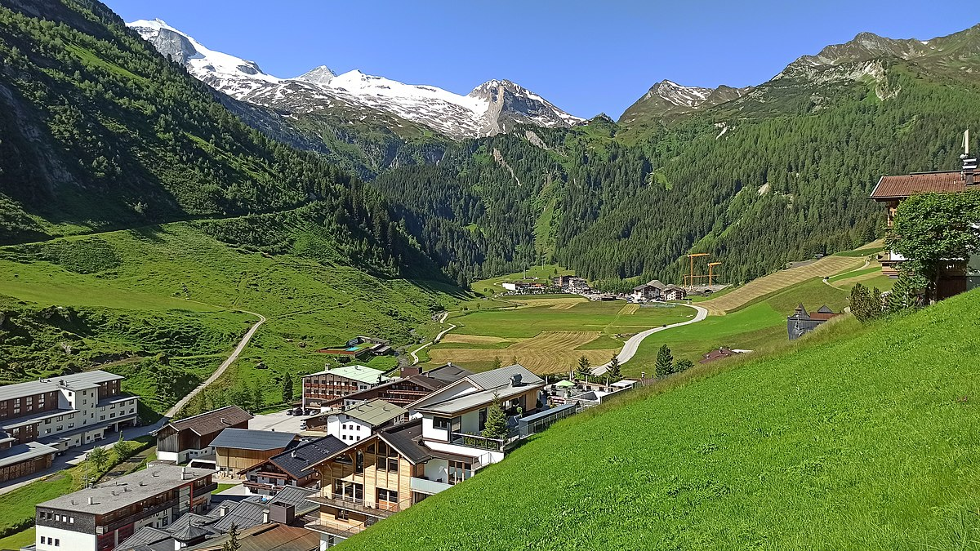
Takeaway: Significant Differences Across Municipalities
Villages and towns show higher employment rates; cities, including Vienna, have elevated unemployment
Villages have a higher rate of secondary education attainment while larger urban areas have rates of tertiary education attainment
Villages tend to have larger household size while cities had a higher proportion of non-Austrian citizens.
TheTokl. 2020. "Village outlet of Hintertux, Austria." Wikimedia Commons, 27 June 2020. https://commons.wikimedia.org/wiki/File:Hintertux,_Austria_%28Village_outlet%29.jpg

